Slide 1
Photo-Monitoring in Mt. Mansfield’s Alpine Zone
Elisabeth Fenn
Green Mountain Club

Slide 2
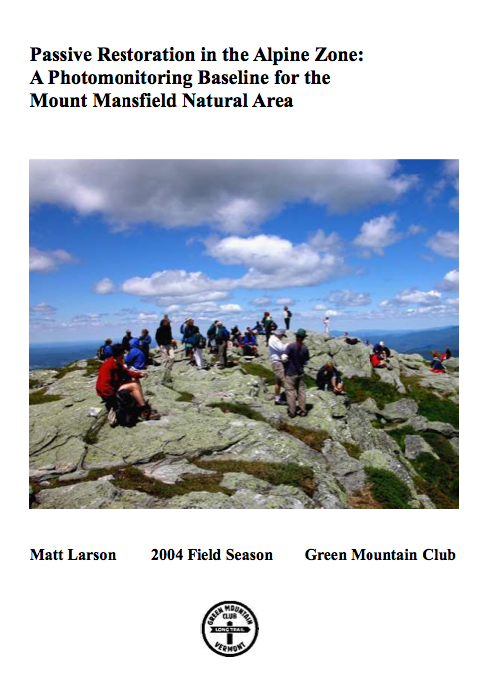
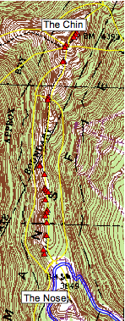
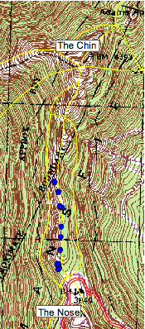
Transect
Quadrat

Slide 3
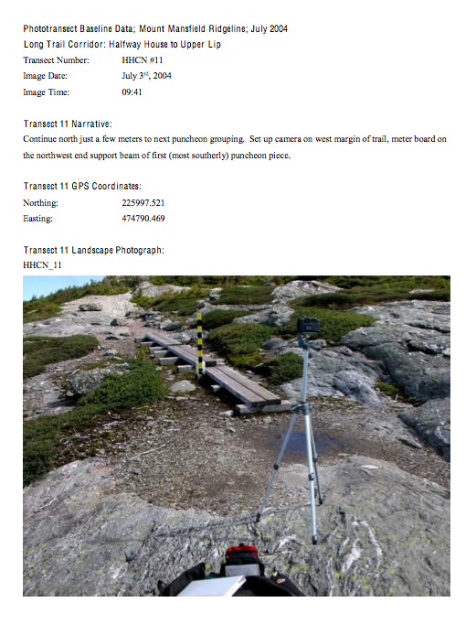
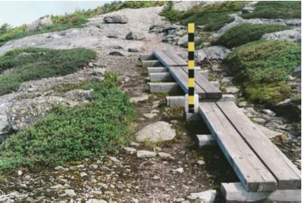
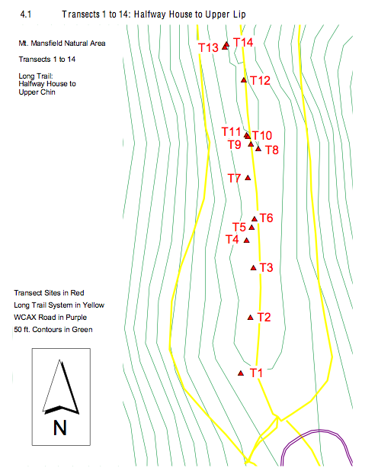

Slide 4
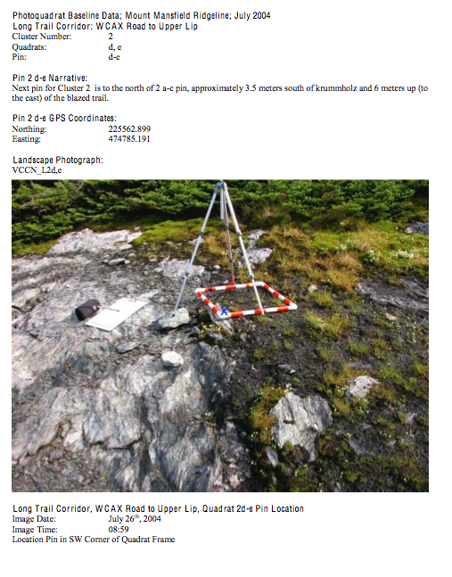
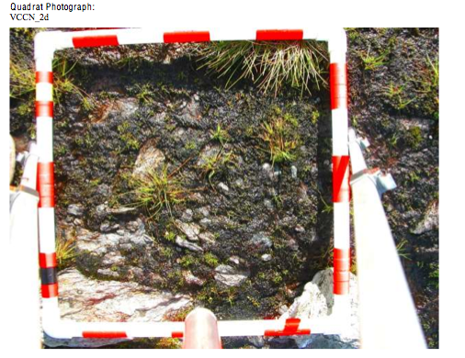
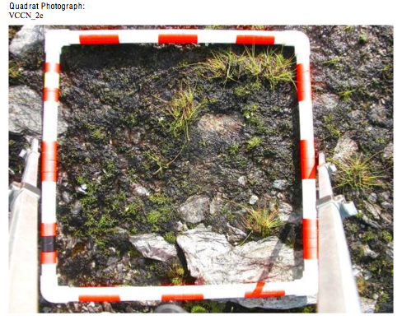

Slide 5
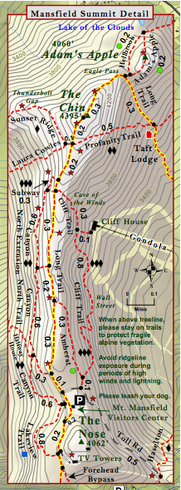
Map of the Mt. Mansfield Ridgeline
Sunset Junction
Drift Rock

Slide 6
Drift Rock
2004
2014
Photo: Matt Larson

Slide 7
Sunset Junction
2004
2014
Photo: Matt Larson

